Slide 1
Hypothesis Testing and Confidence Interval in Linear Regression

Slide 2
11-1 Empirical Models
Many problems in engineering and science involve exploring the relationships between two or more variables.
Regression analysis is a statistical technique that is very useful for these types of problems.
For example, in a chemical process, suppose that the yield of the product is related to the process-operating temperature.
Regression analysis can be used to build a model to predict yield at a given temperature level.

Slide 3
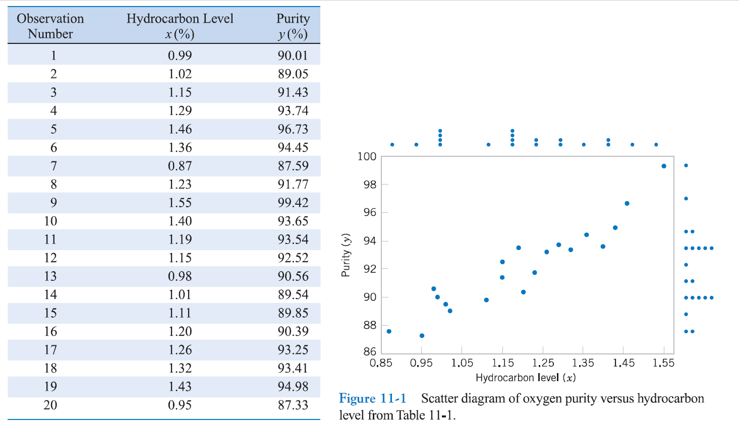

Slide 4
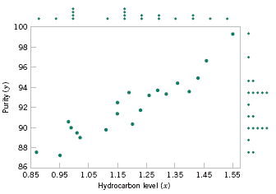
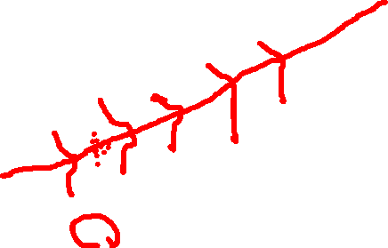
11-1 Empirical Models
Figure 11-1 Scatter Diagram of oxygen purity versus hydrocarbon level from Table 11-1.

Slide 5

11-1 Empirical Models
Based on the scatter diagram, it is probably reasonable to assume that the mean of the random variable Y is related to x by the following straight-line relationship:
where the slope and intercept of the line are called regression coefficients.
The simple linear regression model is given by
where ε is the random error term.

Slide 6

11-1 Empirical Models
We think of the regression model as an empirical model.
Suppose that the mean and variance of ε are 0 and σ², respectively, then
The variance of Y given x is

Slide 7

11-1 Empirical Models
The true regression model is a line of mean values:
where β₁ can be interpreted as the change in the mean of Y for a unit change in x.
Also, the variability of Y at a particular value of x is determined by the error variance, σ².
This implies there is a distribution of Y-values at each x and that the variance of this distribution is the same at each x.

Slide 8
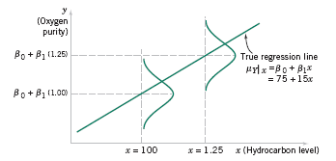
11-1 Empirical Models
Figure 11-2 The distribution of Y for a given value of x for the oxygen purity-hydrocarbon data.

Slide 9
11-2 Simple Linear Regression
The case of simple linear regression considers a single regressor or predictor x and a dependent or response variable Y.
The expected value of Y at each level of x is a random variable:
We assume that each observation, Y, can be described by the model

Slide 10
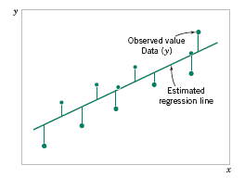
11-2 Simple Linear Regression
Suppose that we have n pairs of observations (x₁, y₁), (x₂, y₂), …, (x_{n}, y_{n}).
Figure 11-3 Deviations of the data from the estimated regression model.

Slide 11


11-2 Simple Linear Regression
The method of least squares is used to estimate the parameters, β₀ and β₁ by minimizing the sum of the squares of the vertical deviations in Figure 11-3.
Figure 11-3 Deviations of the data from the estimated regression model.

Slide 12


11-2 Simple Linear Regression
Using Equation 11-2, the n observations in the sample can be expressed as
The sum of the squares of the deviations of the observations from the true regression line is

Slide 13
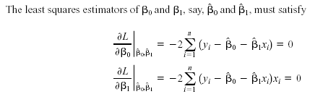
11-2 Simple Linear Regression

Slide 14
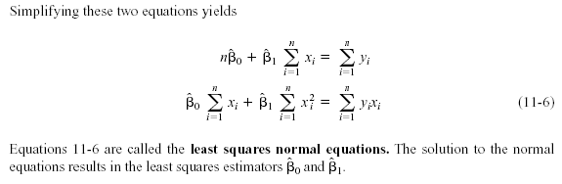
11-2 Simple Linear Regression

Slide 15
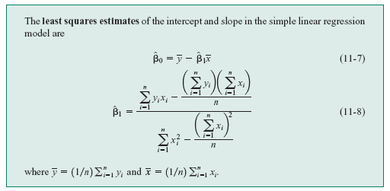

11-2 Simple Linear Regression
Definition

Slide 16
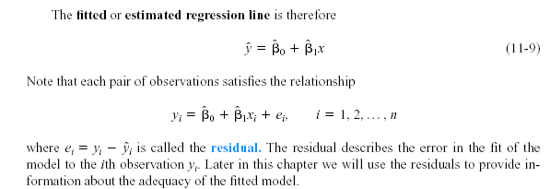

11-2 Simple Linear Regression

Slide 17


11-2 Simple Linear Regression
Notation

Slide 18
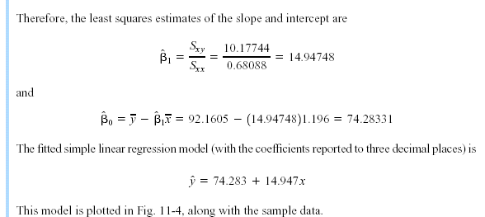

11-2 Simple Linear Regression
Example 11-1

Slide 19
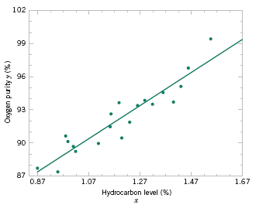
11-2 Simple Linear Regression
Example 11-1
Figure 11-4 Scatter plot of oxygen purity y versus hydrocarbon level x and regression model ŷ = 74.20 + 14.97x.

Slide 20

11-2 Simple Linear Regression
Estimating σ²
The error sum of squares is
It can be shown that the expected value of the error sum of squares is E(SS_{E}) = (n – 2)σ².

Slide 21


11-2 Simple Linear Regression
Estimating σ²
An unbiased estimator of σ² is
where SS_{E} can be easily computed using

Slide 22


11-3 Properties of the Least Squares Estimators
Slope Properties
Intercept Properties

Slide 23


11-4 Hypothesis Tests in Simple Linear Regression
11-4.1 Use of t-Tests
Suppose we wish to test
An appropriate test statistic would be

Slide 24


11-4 Hypothesis Tests in Simple Linear Regression
11-4.1 Use of t-Tests
The test statistic could also be written as:
We would reject the null hypothesis if

Slide 25


11-4 Hypothesis Tests in Simple Linear Regression
11-4.1 Use of t-Tests
Suppose we wish to test
An appropriate test statistic would be

Slide 26
11-4 Hypothesis Tests in Simple Linear Regression
11-4.1 Use of t-Tests
We would reject the null hypothesis if

Slide 27

11-4 Hypothesis Tests in Simple Linear Regression
11-4.1 Use of t-Tests
An important special case of the hypotheses of Equation 11-18 is
These hypotheses relate to the significance of regression.
Failure to reject H₀ is equivalent to concluding that there is no linear relationship between x and Y.

Slide 28





11-4 Hypothesis Tests in Simple Linear Regression
Figure 11-5 The hypothesis H₀: β₁ = 0 is not rejected.

Slide 29





11-4 Hypothesis Tests in Simple Linear Regression
Figure 11-6 The hypothesis H₀: β₁ = 0 is rejected.

Slide 30
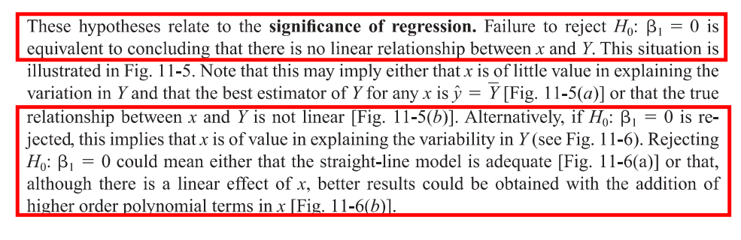

Slide 31
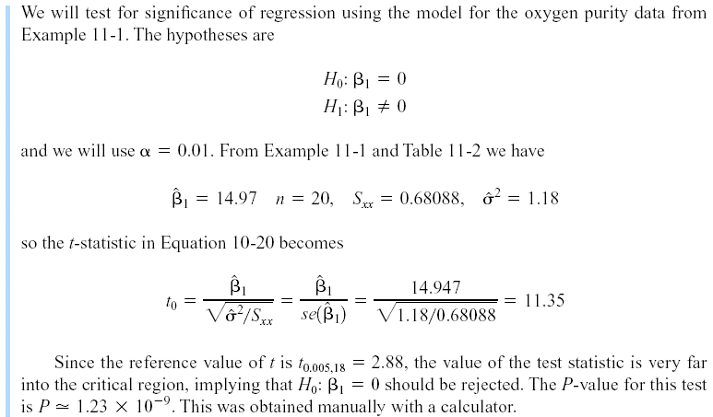
11-4 Hypothesis Tests in Simple Linear Regression
Example 11-2

Slide 32
11-5 Confidence Intervals
11-5.1 Confidence Intervals on the Slope and Intercept
Definition

Slide 33
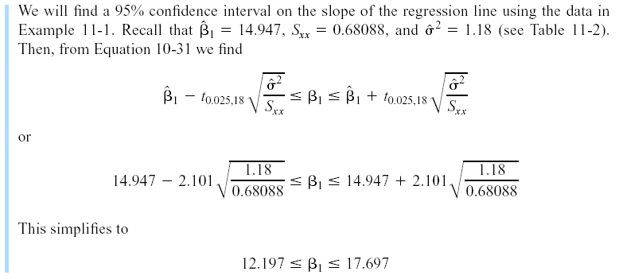
11-6 Confidence Intervals
Example 11-4

Slide 34
11-5 Confidence Intervals
11-5.2 Confidence Interval on the Mean Response
Definition

Slide 35
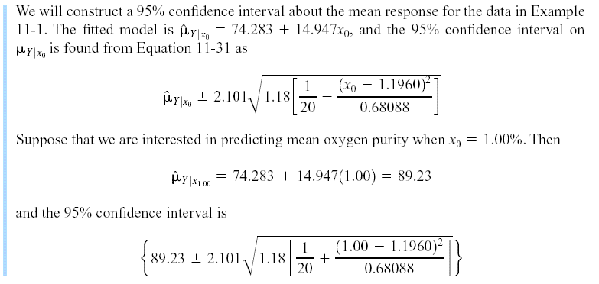
11-5 Confidence Intervals
Example 11-5

Slide 36
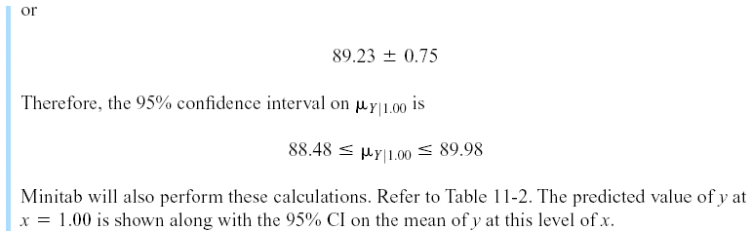
11-5 Confidence Intervals
Example 11-5

Slide 37
11-7 Adequacy of the Regression Model
Fitting a regression model requires several assumptions.
Errors are uncorrelated random variables with mean zero;
Errors have constant variance; and,
Errors be normally distributed.
The analyst should always consider the validity of these assumptions to be doubtful and conduct analyses to examine the adequacy of the model

